Slide 1
Deep Learning Project Presentation
Group - 4
Notes:
Hello

Slide 2
Fake News
Detection
Kalyan Ram Goriparthi – 50496104
Vatsalya Anand – 50495187

Slide 3

Introduction
Identifying and combating fake news is crucial. False information spreads quickly through social media and online sources, negatively impacting individuals, society, and democracy. To address this issue, we need effective detection models that use NLP and deep learning. Detecting fake news empowers people to make informed decisions, fight misinformation, and protect our information ecosystem. In conclusion, detecting fake news is essential in the digital age to combat misinformation, protect people, and uphold truth and accuracy in society.
Notes:
In the digital age, it is important to identify and fight fake news. False information spreads rapidly on social media and the internet, causing harm to individuals, society, and democracy. To solve this problem, we need powerful detection models that use NLP and deep learning. Detecting fake news helps people make better choices, combat misinformation, and safeguard our information system.

Slide 4
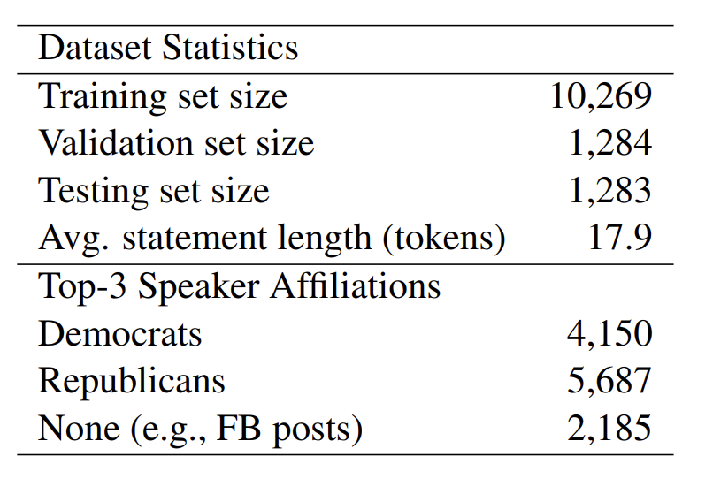
Dataset
The LIAR dataset is a collection of short statements made by politicians, which have been labeled for their truthfulness. The dataset contains over 10,000 statements, which have been split into training, testing, and validation sets. The purpose of the dataset is to provide a resource for training and testing models that can automatically detect lies in political speech. It was first used in “Liar, Liar Pants on Fire”: A New Benchmark Dataset for Fake News Detection by William Yang Wang.
Notes:
The LIAR dataset has 10,000+ short statements by politicians, labeled for truthfulness. It's divided into training, testing, and validation sets. William Yang Wang introduced it in "Liar, Liar Pants on Fire": A New Benchmark Dataset for Fake News Detection. The dataset helps train and test models for automatic lie detection in political speech.

Slide 5
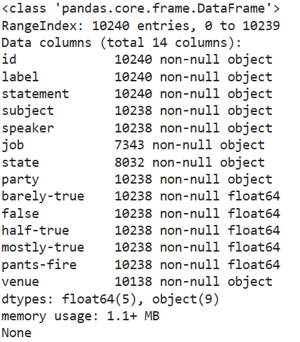
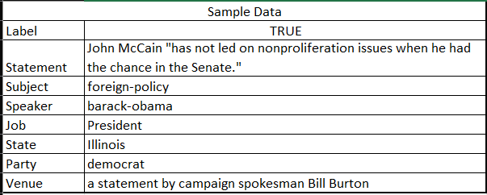
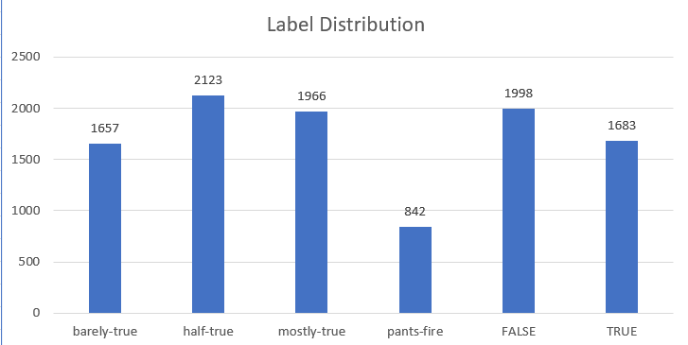
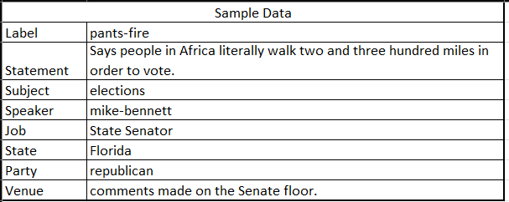
Data Analysis
Notes:
after we loaded the data
there are some missing headers so we added it
we have done label distribution and calculated how many times the label is occured

Slide 6

Data Loading and Preprocessing
Firstly, load the Liar dataset. Next, apply tokenization to the sentences. Tokenization includes the following steps:
Punctuation removal: Remove punctuation from the sentence.
White space separation: Convert the sentence into a list of words.
Indexing: Assign a unique index to all the unique words in the dataset.
Conversion: Replace each word with its unique index.
Notes:
The first step is to load the dataset.
Then, the text instructs to apply tokenization to the sentences in the dataset. Tokenization involves several steps: removing punctuation from the sentences, separating the sentences into a list of words based on white spaces, assigning a unique index to each unique word in the dataset, and finally replacing each word with its unique index.

Slide 7
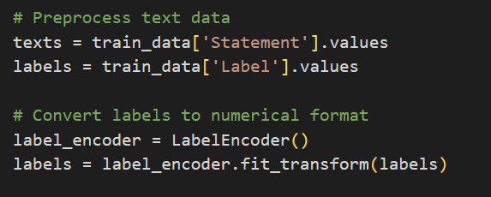
Data Loading and Preprocessing
Data Extraction: We separate the dataset into two parts: independent variables and target variable. The independent variable is the statement column, and the target variable is the Label column.
Label Encoding: We convert the values in the label column into binary values, either 0 or 1. This helps us determine whether the news is fake or real.
Notes:
Extracting data - We divide the dataset into independent variables and target variable. Independent variable is the statement column. Target variable is Label column.
Next we apply label encoder to the label column, so that the values of label column are changed into binary values either 0 or 1 which determines whether the news is fake or real.

Slide 8

Models – LSTM
LSTM, is a type of Recurrent Neural Network, It effectively captures sequential dependencies in text, models long-term relationships, adapts to variable-length sequences, and learns features indicative of misinformation. Its memory cell aids in retaining important context over longer sequences, making it suitable for understanding the historical context within news articles.
Notes:
LSTM is a type of Recurrent Neural Network that captures sequential dependencies in text, models long-term relationships, adapts to variable-length sequences, and learns features that indicate misinformation. Its memory cell retains context over longer sequences, making it suitable for understanding historical context in news articles.
First, we pass the input through an embedding layer. The input dimension is the number of unique words, and the output dimension is 100.
Next, we pass it through an LSTM layer, which then passes through a dense layer.
The final output is passed through a sigmoid activation function, which gives a range between 0 and 1.

Slide 9

Models – BiLSTM
Bi-LSTMs were utilized to capture contextual dependencies in both the forward and backward directions. They help in understanding word context, handling variable-length sequences, effectively managing memory, addressing the vanishing gradient problem, and extracting features for identifying patterns of misinformation in news articles.
Notes:
Bi-LSTMs were used to capture contextual dependencies in both forward and backward directions, understand word context, handle variable-length sequences, manage memory effectively, address the vanishing gradient problem, and extract features for identifying patterns of misinformation in news articles.
Firstly, we are passing embedding layer output through 1D Convolutional layer and then downsampling by applying max pooling operation
Next the output is passed sequentially through 2 dense layer and then through sigmoid activation function

Slide 10

Models – CNN
Convolutional Neural Networks (CNNs) are used because they are good at capturing local patterns in sequential data, such as text. CNNs can learn features and relationships between words automatically by using word embeddings and transfer learning. Their ability to handle sequential information and share parameters efficiently makes them suitable for identifying patterns that indicate misinformation in news articles.
Notes:
Convolutional Neural Networks (CNNs) are used to capture local patterns in text data. They learn features and relationships between words using word embeddings and transfer learning. CNNs are efficient in handling sequential information and can identify patterns indicating misinformation in news articles.
Here we passing embedding layer output through 1D Convolutional layer and then downsampling by applying max pooling operation
Next the output is passed sequentially through 2 dense layer and then through sigmoid activation function

Slide 11

Classification
Dataset had 6 point scale for labels:“pants on fire”, “false”, “barely true”, “half true”, “mostly true”,”true”
We went with two approaches:
6 way
2 way

Slide 12
Optimizer and Loss Function
Optimizer: Adam
Loss Function
6 way: Sparse Categorical Crossentropy
2 way: Binary Crossentropy

Slide 13
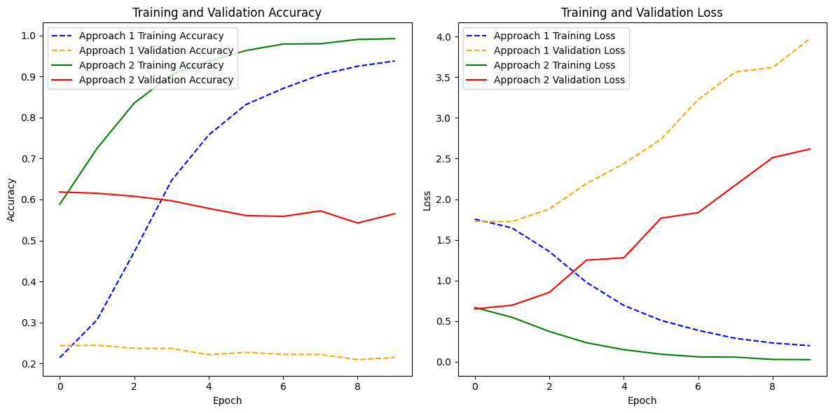
LSTM

Slide 14
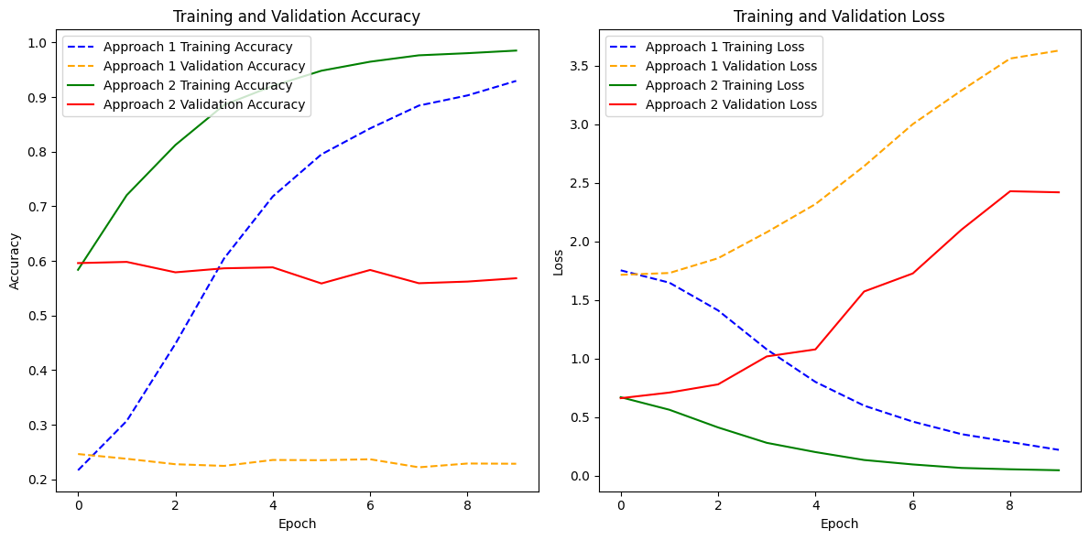
Bi-LSTM

Slide 15
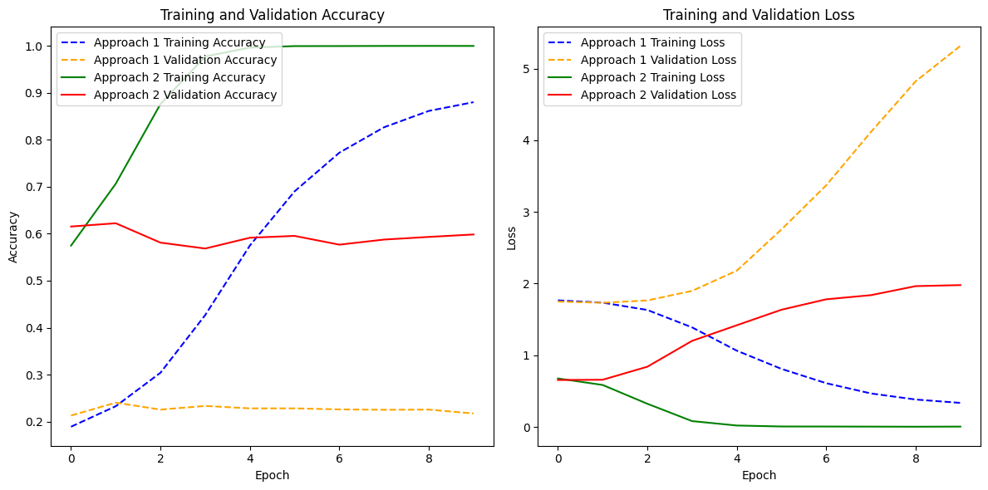
CNN

Slide 16
Results
 | Testing Accuracy |  | Validation Accuracy
 | Classification |  | Classification
Model | 2-way | 6-way | 2-way | 6-way
LSTM | 56.51 | 21.39 | 56.53 | 21.48
Bi-LSTM | 56.59 | 22.49 | 56.83 | 22.86
CNN | 60.93 | 22.10 | 59.83 | 21.74

Slide 17
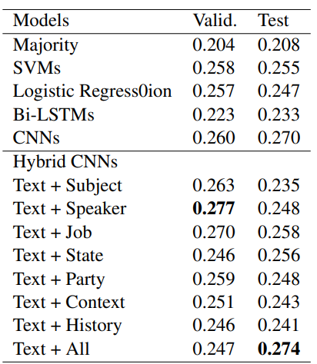
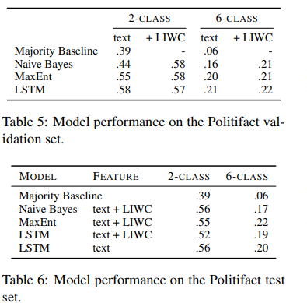
Comparison
Ref: Liar, Liar Pants on Fire
Ref: Truth of Varying Shades

Slide 18
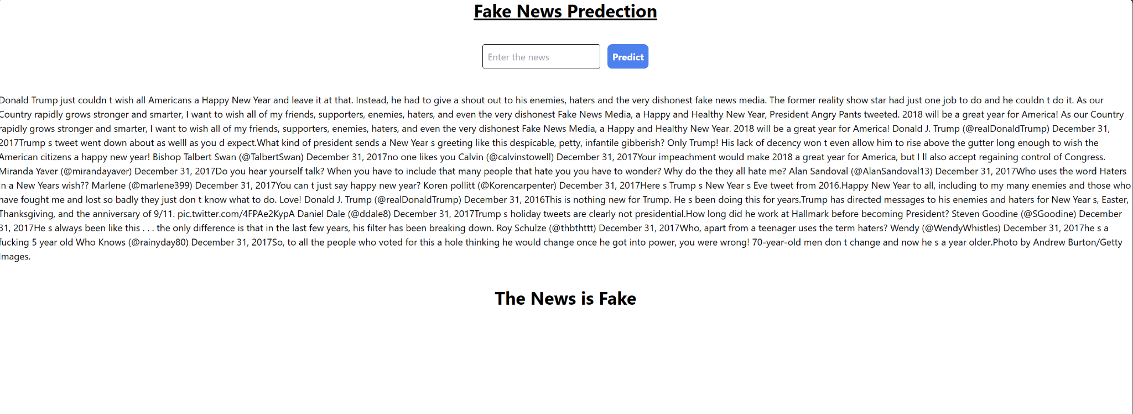
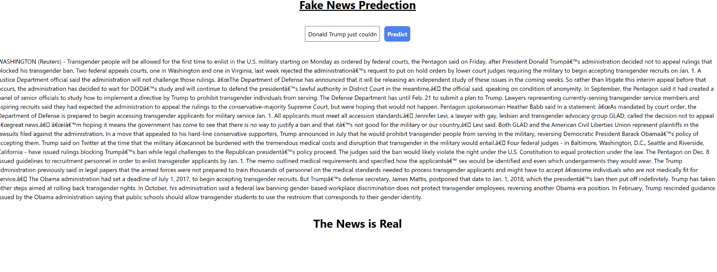
Web Integration

Slide 19
References
1.William Yang Wang 2017 “Liar, Liar Pants on Fire”: A New Benchmark Dataset for Fake News Detection https://arxiv.org/pdf/1705.00648.pdf
2.Hannah Rashkin Eunsol Choi Jin Yea Jang Svitlana Volkova Yejin Choi 2017 Truth of Varying Shades: Analyzing Language in Fake News and Political Fact-Checking https://aclanthology.org/D17-1317.pdf

